Slide 1
Financial News Headlines Analysis Project - Stock Market Fin - LAFIO
May 25, 2022

Slide 2
Fin-LAFIO Team
Domain Experts
IT Experts
Lina Shbaitah
Issa Baitouni
Omar Ja`bari
Ayman Khalaf
Firas Abu Nimreh

Slide 3
Project Persona
Pain
B 2 C
Stage 1
Beginner / New investors
“has only basic knowledge about investments”
“looking for helpful tool & advise”
“ lots of information and sources “
Mid – Experienced Investors
“ looking for trusted one source to summarize information “
B2 B
Stage 2
Experienced Investors
“Squeezed Time”
“lots of resources ”
“Looking for deep analysis ”
Businesses/Traders
“Make the decision on behalf of investors”
“Looking for prediction ”

Slide 4
Problem Statement and Value Proposition
It is overwhelming for investors to decide to buy, sell or keep a stock.
Many aspects to consider when deciding.
The stock price is determined by supply and demand,
Stock price are affected positively or negatively by many factors including; news headlines, company value/performance, key people analysis, and gossip in the market.

Slide 5
Fin-LAFIO Idea & Solution
Fin- LAFIO's role will gather all these elements in one place and make the process easier and more insightful for users.
Create a platform to help people, who are interested in the stock market, make their investment decision easier.
Provides Insights extracted, collected and analysed from:
Company performance
News Headlines
Blogs, tweets, influencer Speech, Analysts
Community shares and talks
Gossip in the market

Slide 6
Fin-LAFIO Features
One-Stop-Shop
Easy to Use
Insightsfull
Sentimental Analysis
Prediction
Dashboards

Slide 7
Competitors
Tiingo.com
seekingalpha.com
Pros:
Unlimited articles with investing ideas
Valuable quant, Wall Street Analyst, and author ratings
Ability to track personal portfolio performance
Screening & Comparison tools that let you filter out irrelevant investments
Concierge service (Pro only) and personalized alerts.
Several Packages
Pros:
Data for more than 80,000 global stocks
Flexible beta and correlation analyses
Build custom indicators for screening stocks
Powerful API with stock, forex, and crypto data
Most data and tools are available for free.
Cons:
Web interface requires a learning curve
Custom indicators and API require coding
Cons:
High cost for casual investors (especially if getting the Pro plan)
Crowded
Minimal mutual fund coverage
Won't invest for you like robo-advisors

Slide 8
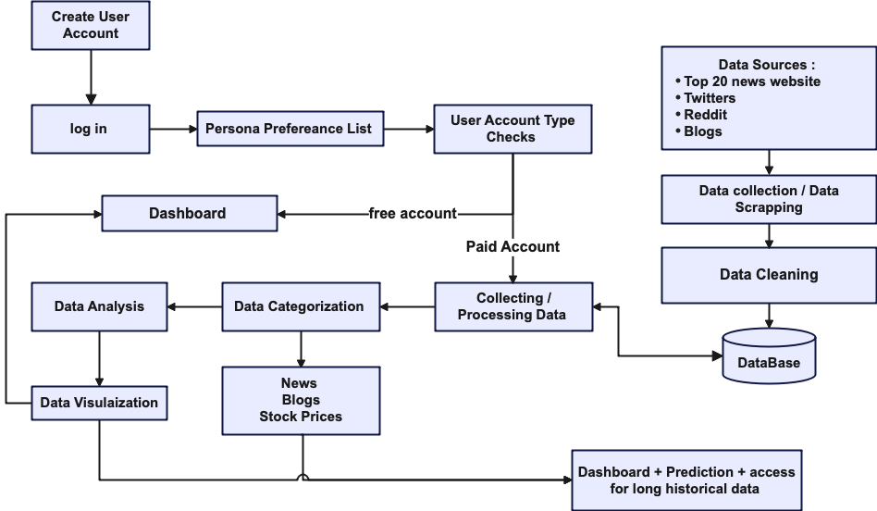
Data Flow

Slide 9
Web Application Screens

Slide 10
Thank You
Fin – LAFIO Team

